Slide 1

Impact of COVID-19 on Mental Health in United States
Group D1: Jie Feng, Jungkyu Kim, Riley Williamson,
Rodney Davemann,Veera Supraja Koppisetty,
Felix Ogbodu
Instructor: Thomas Raczkowski
TA: Sumit Malik

Slide 2
Introduction
Background:
The COVID‑19 pandemic and it’s associated public health measures have disturbed the lives of people all around the world. It is evident that the indirect and direct social and psychological effects of the pandemic are pernicious and affects the mental health of the human beings.
Questions:
Has COVID_19 affected the mental health of Americans?
Are areas high COVID-19 deaths more impacted by mental health issues?
Do areas with low COVID-19 rates have lower rates of mental health issues?
How has Georgia been impacted?

Slide 3
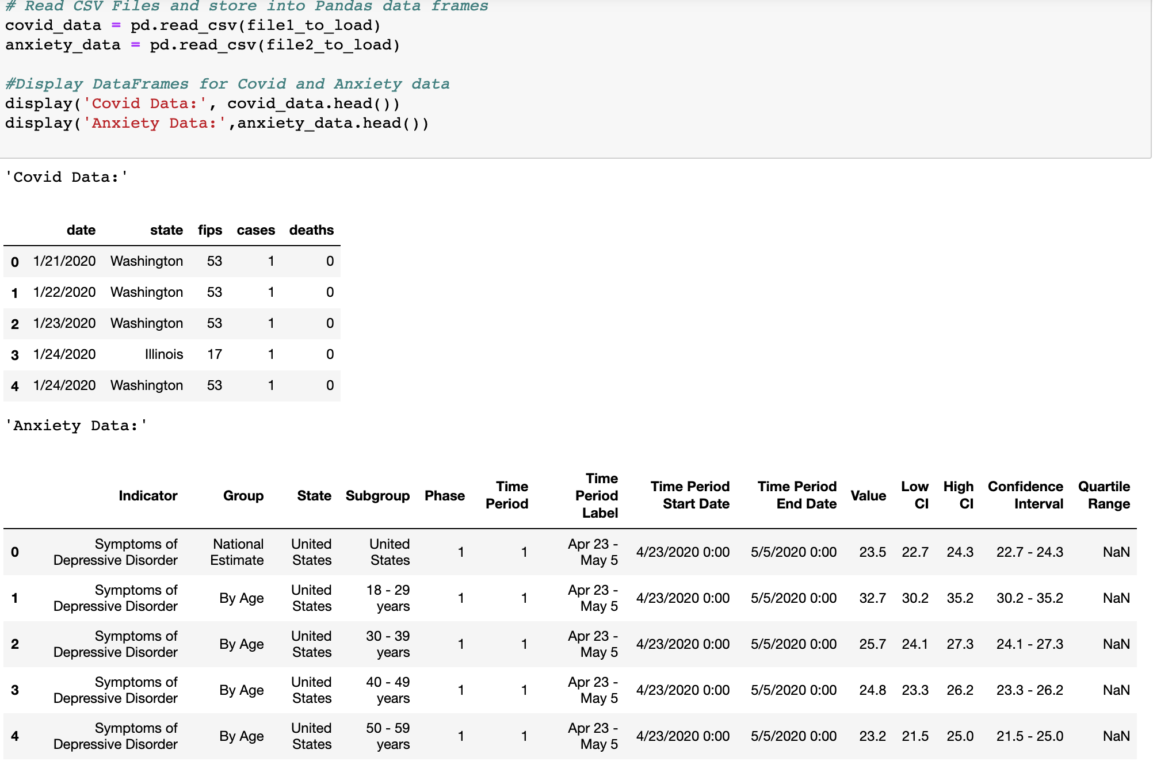
Data importation
Datasets:
Indicators_of_Anxiety_or_Depression_Based_on_Reported_Frequency_of_Symptoms_During_Last_7_Days(also called Anxiety_data)
COVID_Cases_And_Deaths_Data_From_2020_to_2021(Also called us_states )
We have got our required covid data , anxiety deaths data from CDC since 2020
Number of rows in Covid Data set : 23059
Number of rows in Anxiety Data set : 5784

Slide 4
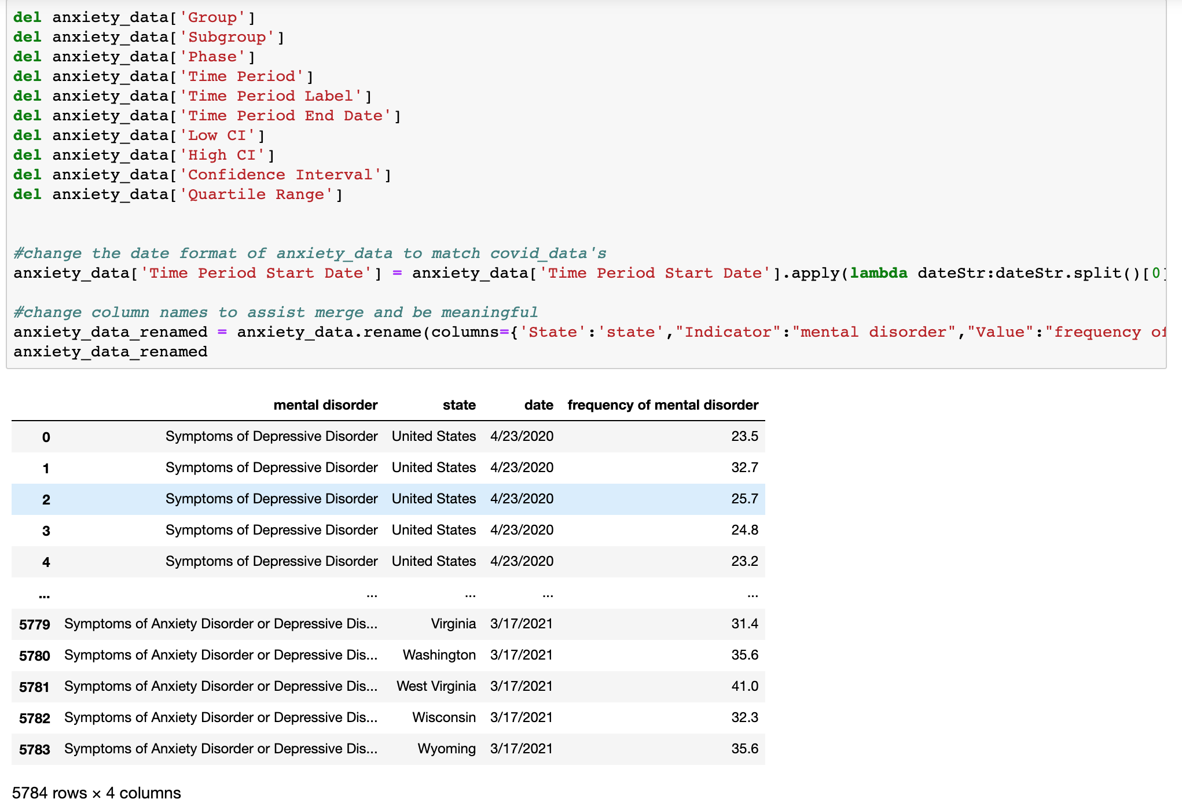
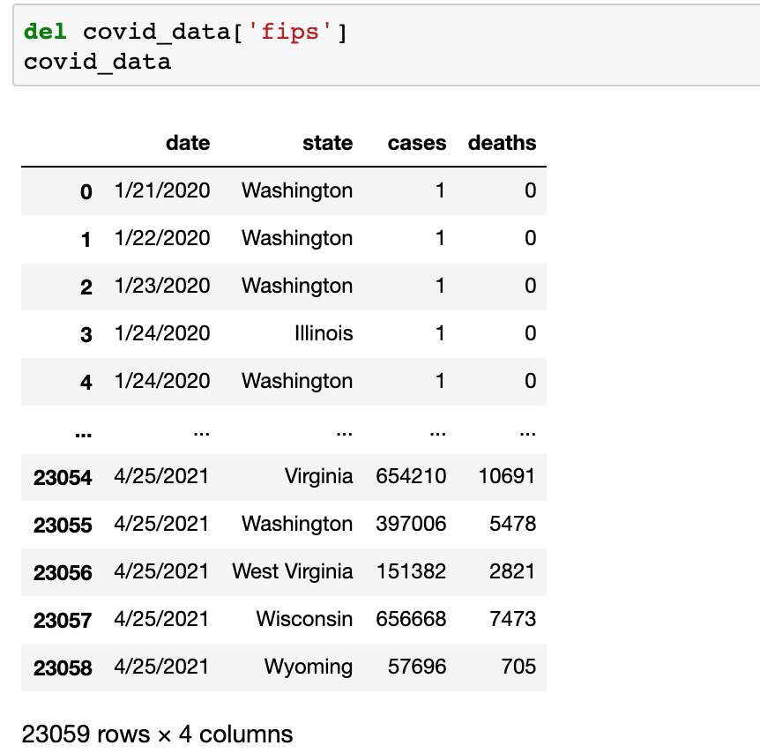
Data Cleaning
Imported CSV files as Data frames
Deleted unnecessary columns

Slide 5
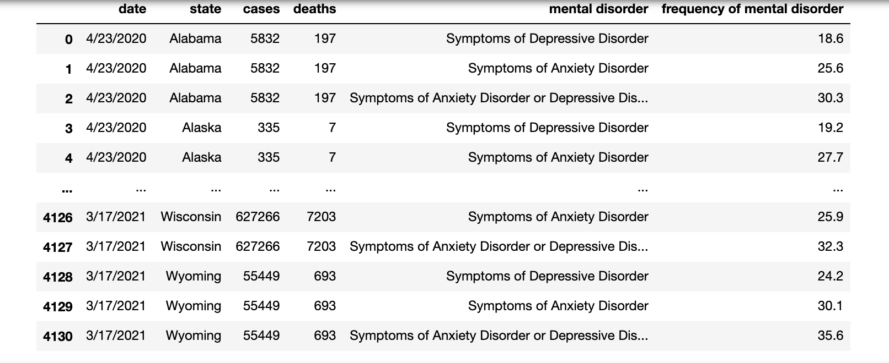
Data merging
Merge conducted on the common column i.e., state
After the merge:
Number of rows in Merged Data set: 4131

Slide 6
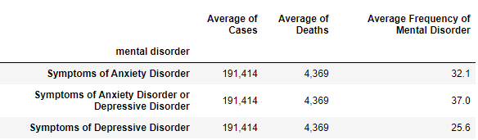
Data analysis: Frequency Table

Slide 7
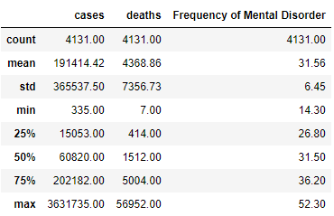
Data Analysis: Statistics

Slide 8
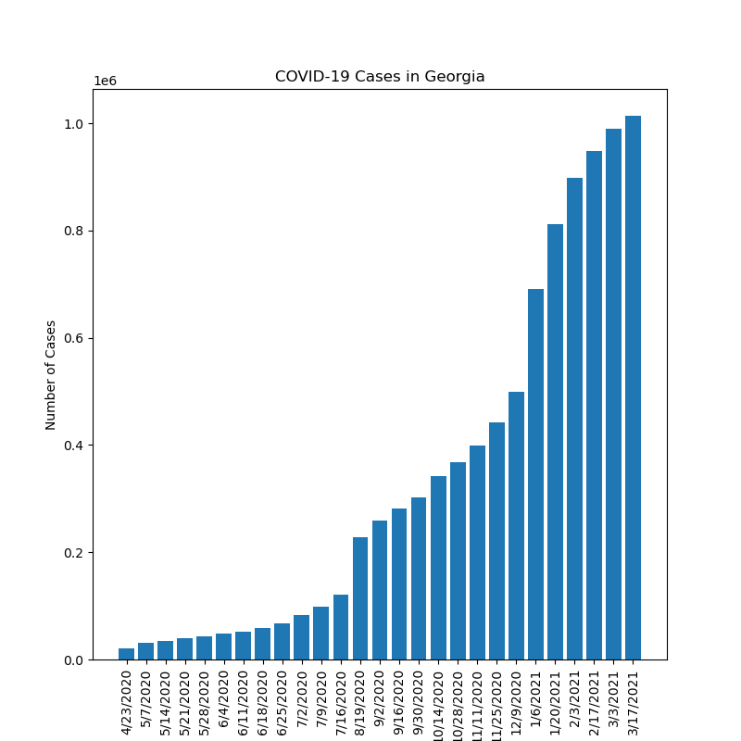
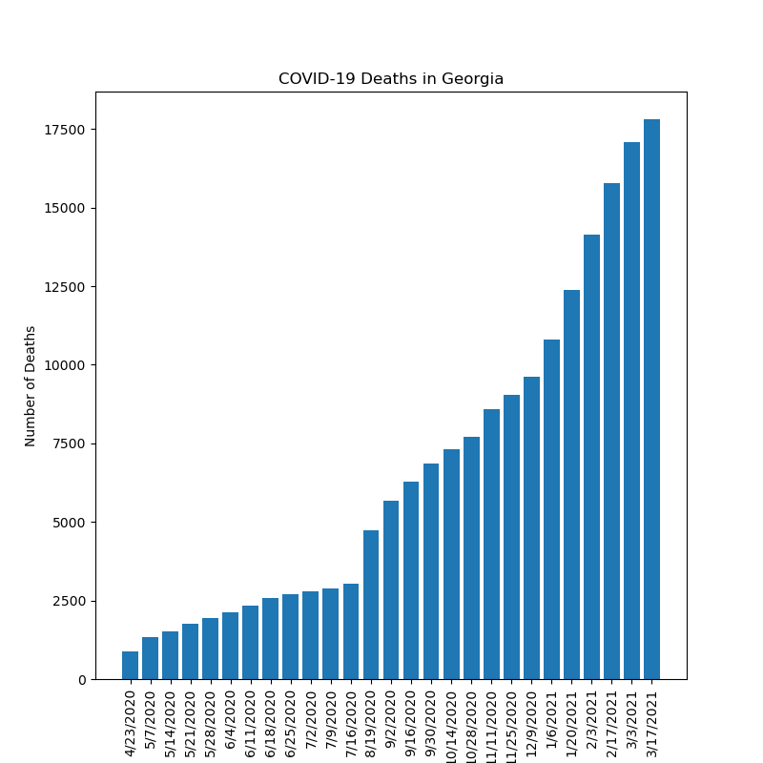
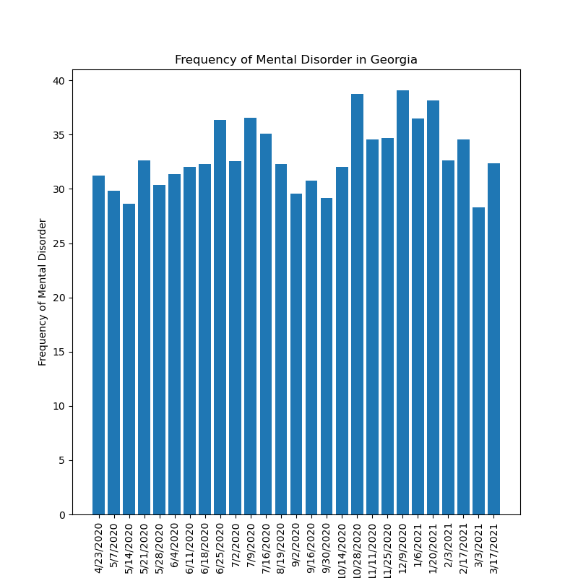
Data analysis Question: How has Georgia been impacted?
From March 2020 to April 2021, the Covid-19 cases and deaths increased with the time passed.
The frequency of mental disorder did not change much during this period.

Slide 9
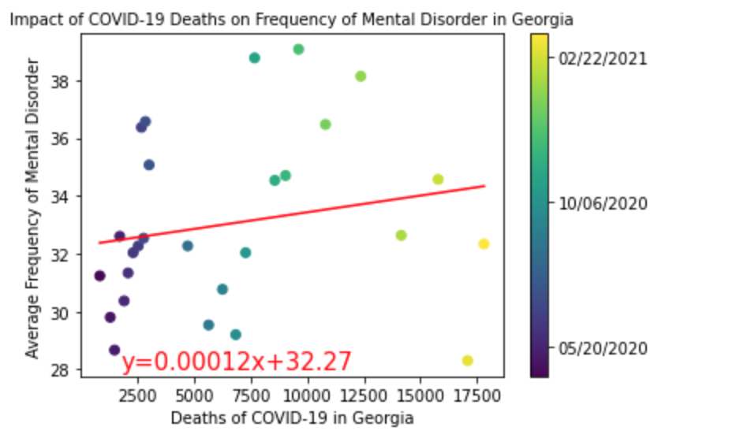
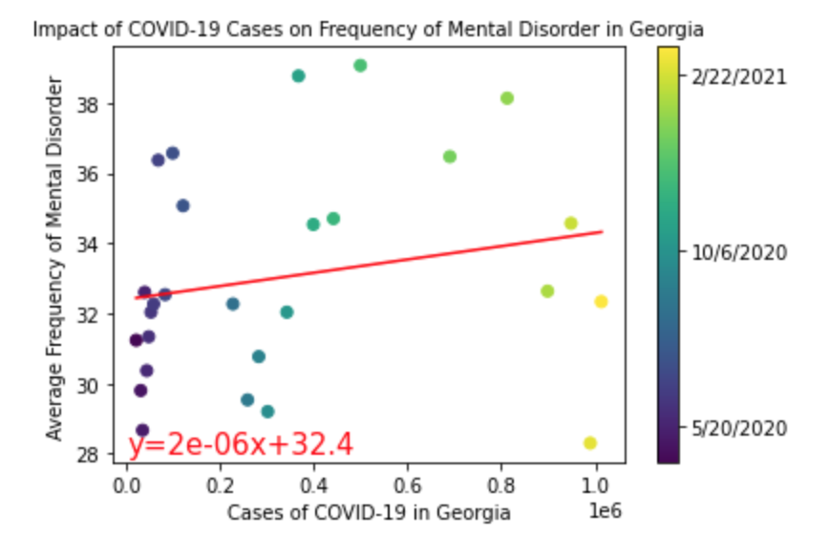
Data analysis Question: How has Georgia been impacted? (continued)
The r value is 0.04.
The r value is 0.04.
Their correlations with covid-19 cases or deaths are weak.

Slide 10
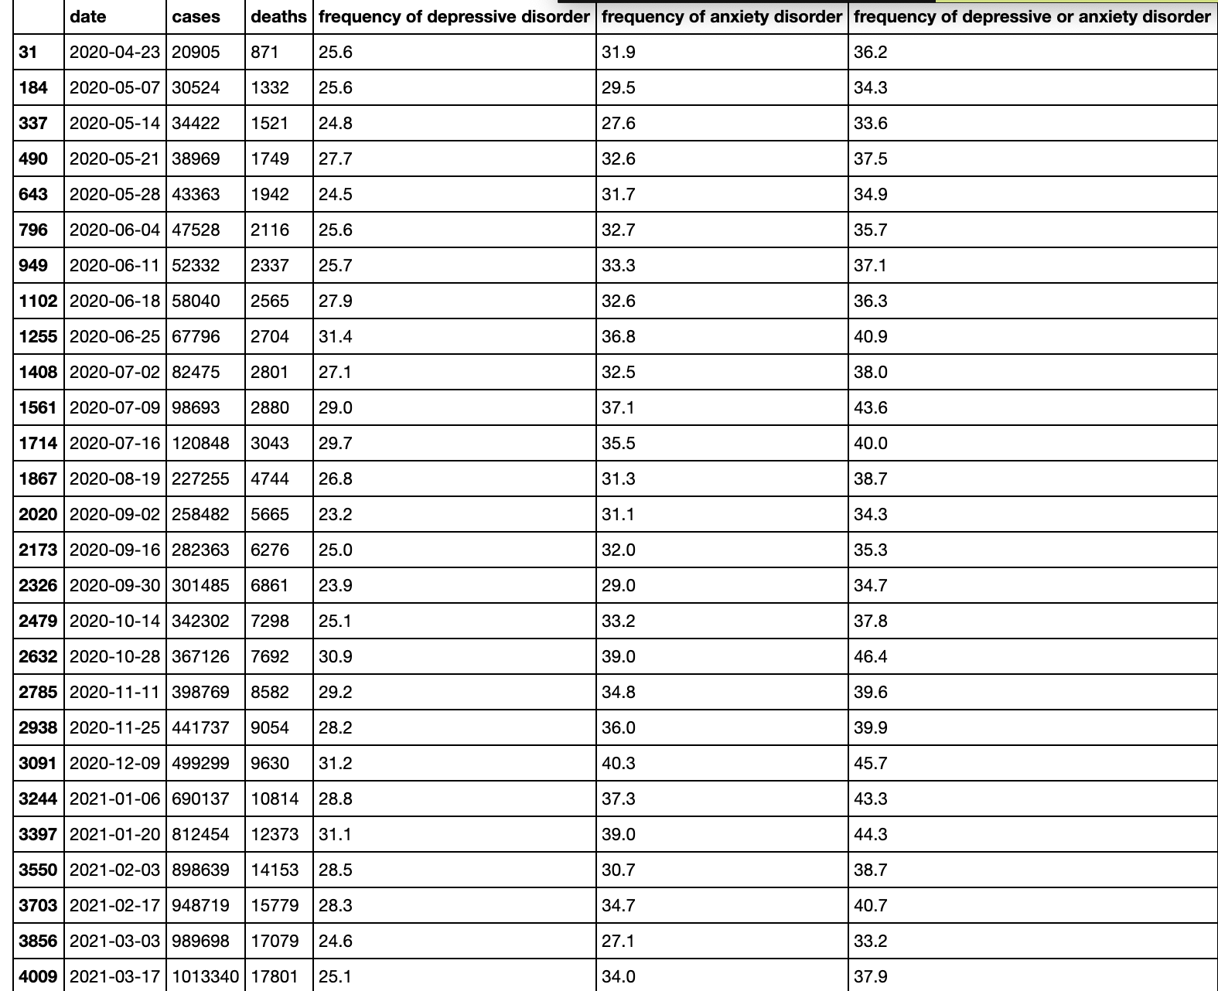
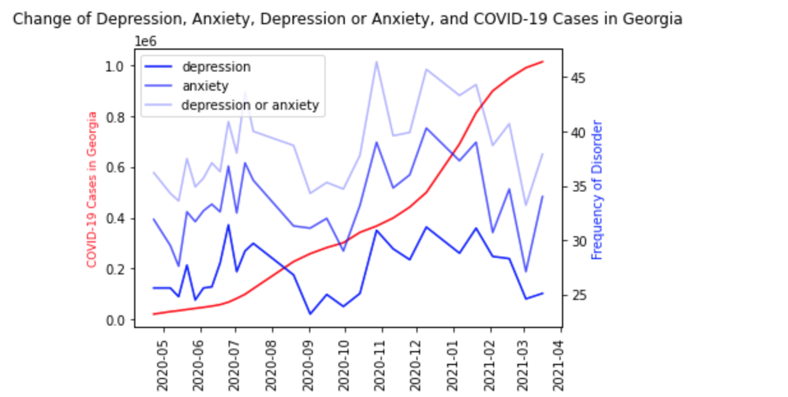
Data analysis Question: How has Georgia been impacted? (continued)
The frequency of depression, anxiety, and depression or anxiety have similar change pattern. They all decreased from July of 2020 to the bottom in October of 2020, then increased again.

Slide 11
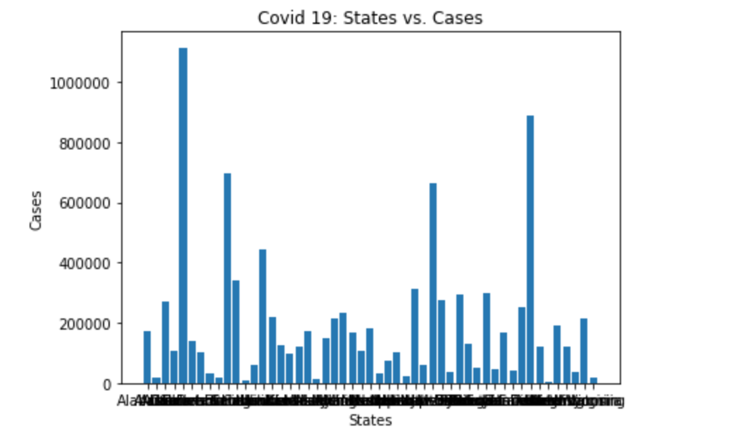
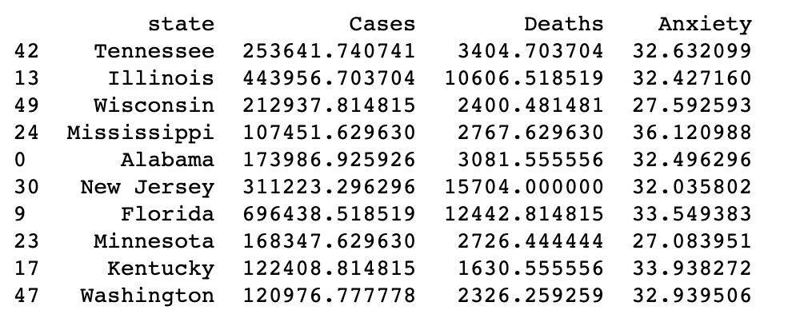
Means and analysis

Slide 12
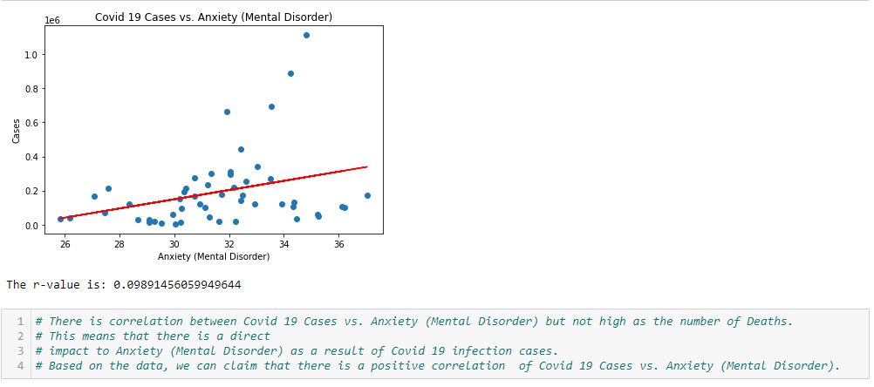
Covid cases vs Frequency of Mental Disorder

Slide 13
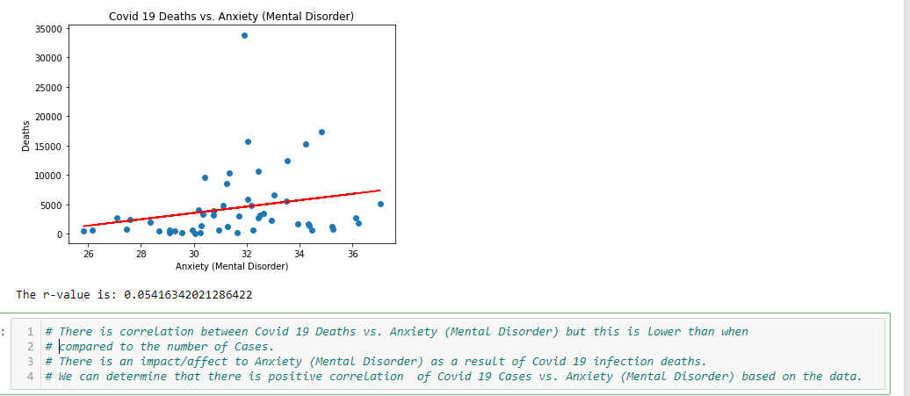
Covid Deaths vs Frequency of Mental Disorder

Slide 14
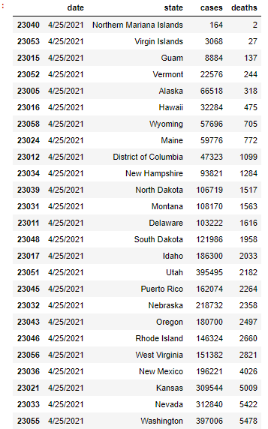
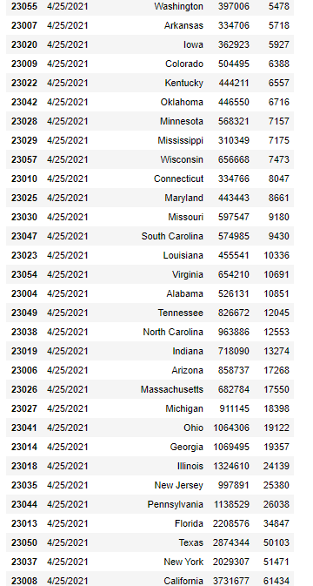
State wise total Deaths from COVID as of 04/25/2021

Slide 15
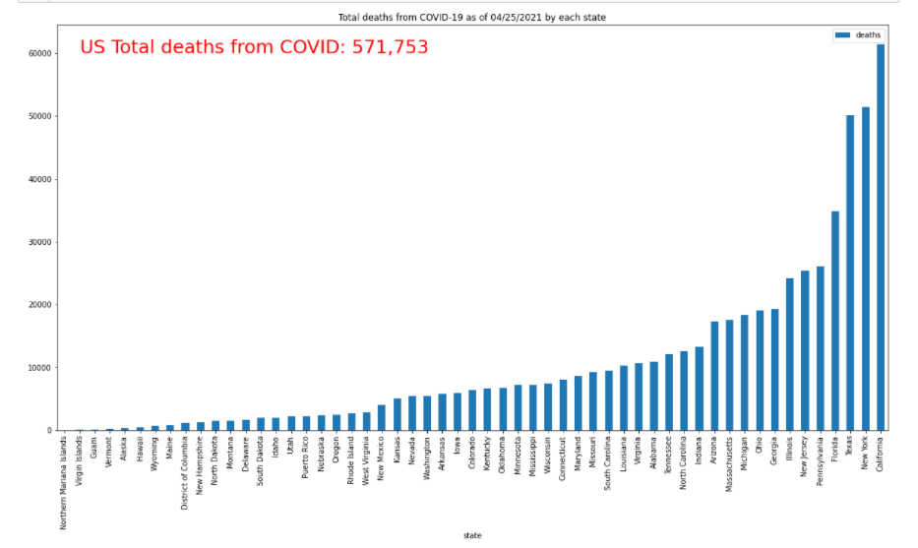
State wise total Deaths from COVID as of 04/25/2021 (continued)

Slide 16
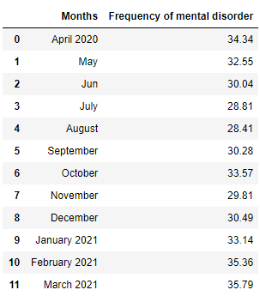
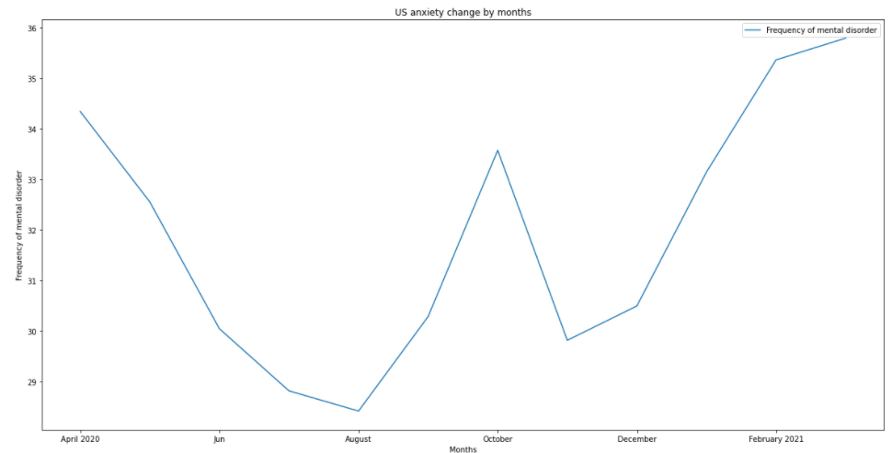
US Mental Disorders by Month
The U.S. average anxiety frequency decreased from April 2020 to August 2020, then slightly increased until February 2021

Slide 17
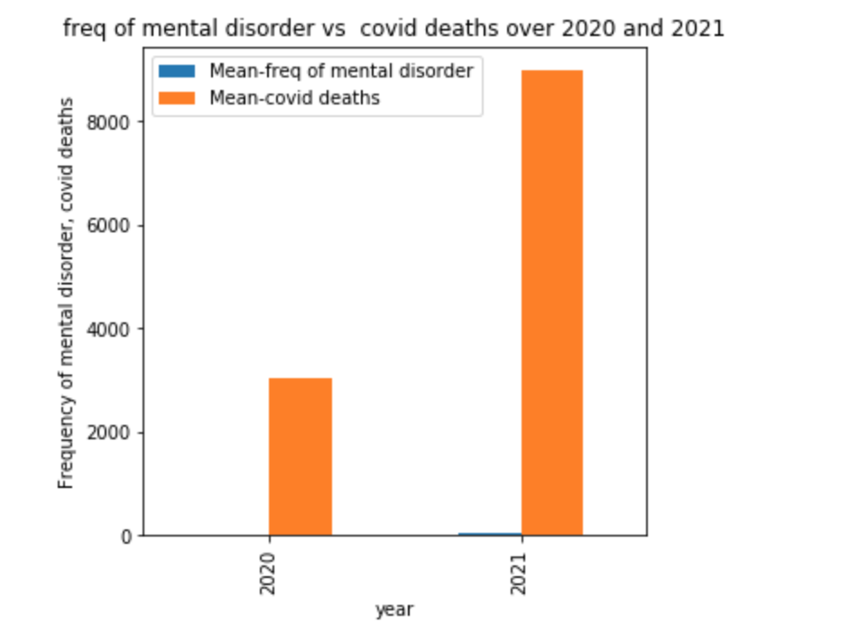
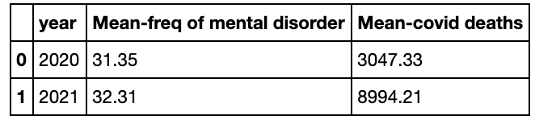
US Mental Disorders by Year
The anxiety and depression levels of Americans remained almost the same during the pandemic with a slight increase over years as observed from the visualization

Slide 18
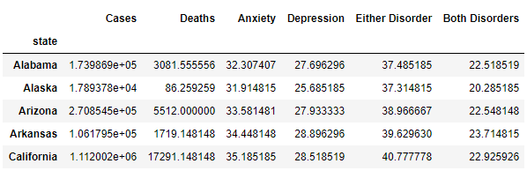
Data Analysis: Data by each disorder

Slide 19
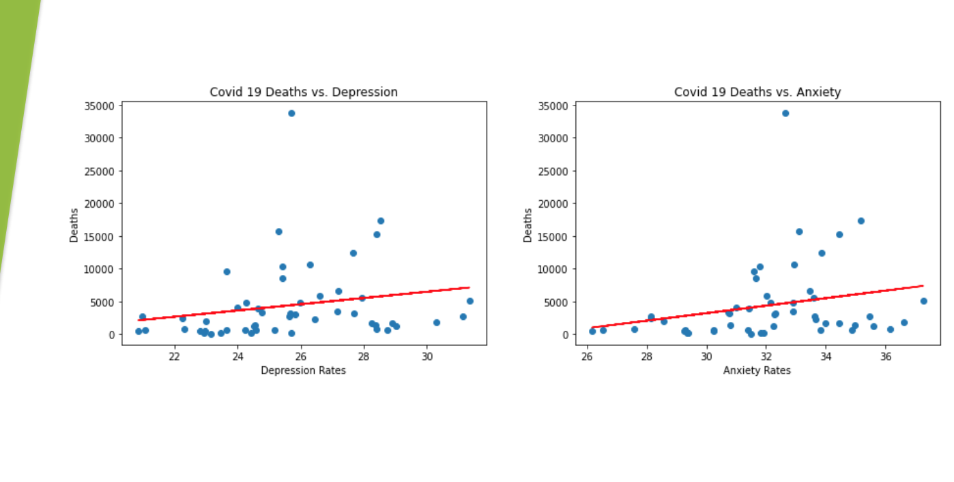
COVID-19 fatality vs Depression, Anxiety

Slide 20
Summary statistics
The total number of cases is 9,762,136.
The total number of deaths is 222,812.
The average rate of anxiety is 32.08%.
The average rate of depression is 25.65%.
The average rate of anxiety or depression symptoms is 36.98%.
The average rate for both anxiety and depression symptoms is 20.72%.

Slide 21
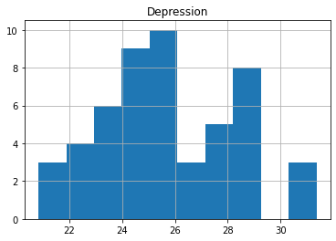
P-test
CDC 2019 Study: 18.5% of Americans have symptoms of depression
H0: 25.63<=18.5 | H1: 25.63>18.5
z-score: 2.795
Confidence level: 95%
p-value: 0.003
Because the p-value is less than the significance level, we have significant evidence to reject the null hypothesis. With this analysis, we can say with 95% confidence that depression rates for Americans have been higher during the pandemic.

Slide 22
Conclusion
From this data, we can conclude that there is a weak positive correlation between COVID-19 and mental illness.
We have evidence that states with higher COVID rates tend to have higher rates of mental disorders. However, this is not consistent.
We also have evidence that the average rate of depression symptoms has increased since the pandemic began.

